Slide 1
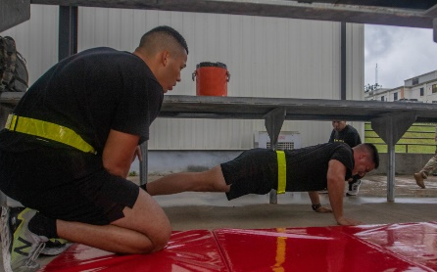
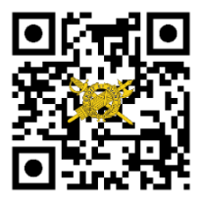
THE
Your Unit
Patch / Crest
Here.
IG UPDATE
Volume 21-3a, May 2021
Supplement to IG Update 21-3: Update to the Army’s Combat Fitness Test —ACFT 3.0
On 29 April 2021, the Acting Secretary of the Army released Army Directive (AD) 2021-14 (Army Physical Fitness Test and Army Combat Fitness Test). This directive, which supersedes AD 2020-06 (Army Combat Fitness Test), 12 June 2020, provides specialists and corporals (E-4s)—of all COMPOs—the opportunity to take the Army Physical Fitness Test (APFT) as a means to fairly compete for promotion or other administrative requirements. This directive allows Soldiers to continue their career advancement as the Army improves its fitness testing and transitions to the Army Combat Fitness Test (ACFT).
During this transition period, commanders and unit leaders should understand their role in implementing this directive by:
Ensuring AD 2021-14 does not impede or inhibit ACFT training, testing, and the recording of test data;
Granting requests from Soldiers to take the APFT, unless doing so will pose a safety risk or impede mission requirements; (Authority to approve or deny requests falls under the first commander in the chain of command.);
Temporarily granting a minimum passing APFT score (60 points per event) to those E-4s who do not have a record APFT score in the Army’s Digital Training Management System (DTMS) and are unable to take an APFT due to deployment or pregnancy/postpartum profile (minimum passing score remains valid only until Soldier is able to take the APFT); and
Recording all APFT and ACFT scores in DTMS.
Unit leaders will never force or pressure Soldiers to take the APFT. Commanders will counsel, in writing, those Soldiers without a record fitness test in DTMS who elect not to take the APFT.
Soldiers should note that:
Those without a recorded APFT score in DTMS who volunteer to take the APFT, pursuant to AD 2021-1, and fail to pass this fitness test won’t be eligible for any previously established personnel/administrative requirements, such as promotion.
Those with a recorded passing APFT score in DTMS who volunteer take the APFT, pursuant to AD 2021-1, in an attempt to improve their score and who fail or do worse on the APFT will retain their former higher score in DTMS for meeting personnel/administrative requirements.
Those with our without a recorded APFT score in DTMS will not be subject to adverse administrative actions (such suspension of favorable actions (flag), initiation of administrative separation, or derogatory/referred evaluation reports). Contact your local inspector general office (on the right) if you suspect this has occurred or you have any questions related to adverse administrative actions.
Your Unit Name Here
Commanding General
MG Soldier Q. Public
Command Sergeant Major
CSM Soldier Q. Public
Command Inspector General
LTC Soldier Q. Public
Inspector General NCOIC
SGM Soldier Q. Public
IG Points of Contact
Unit IG Office
Building 1234
Hooah Drive
Fort Swampy LA 55555
Unit IG Website
https:\IG-bla-bla-bla.mil
Unit IG Office Email
IG-bla-bla@mail.mil
Unit IG Hotline
555-555-5555
Unit IG Office
555-555-5555
Spc. Maical Rivera of the Puerto Rico National Guard
completes the push-up event of the APFT while being
cheered on by his fellow Puerto Rico Army National Guardsman, Sgt. Josue Mendez. (U.S. Army photo)
References
Army Regulation 250-1 (Army Training and Leader Development)
Field Manual 7-22 (Holistic Health and Fitness)
Army Techniques Publication 7-22.01 ( Holistic Health and Fitness Testing)
Assistant Secretary of the Army for Manpower and Reserve Affairs SAMR memorandum (Supplemental Guidance #3-Records Management Guidance for the Army’s Provisional Fitness Test Scorecard Forms)
ig.army.mil
References
SMA Sends (ACFT), 22 March 2021.
Army Directive 2020-06 (Army Combat Fitness Test), 12 June 2020.
HQDA EXORD 144-21 (Army Physical Fitness Training and Testing for FY21-22), 22 March 2021.
Resources
www.army.mil/ACFT
ACFT PRT App (Available on Android and iOs).

